Slide 1
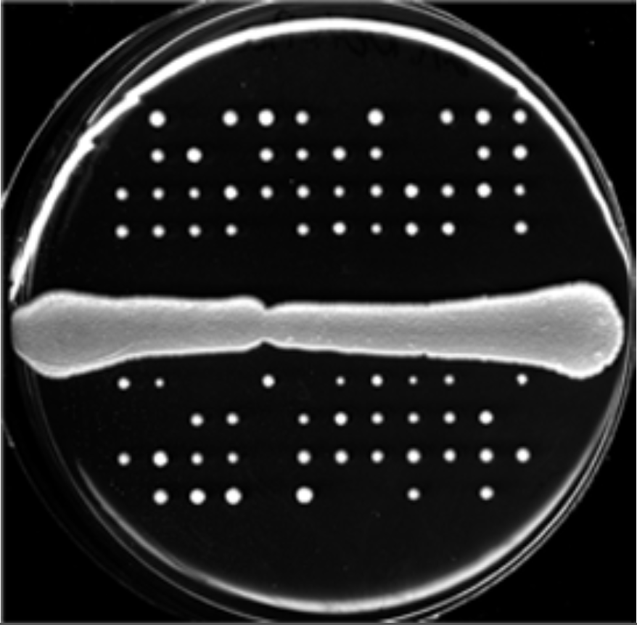
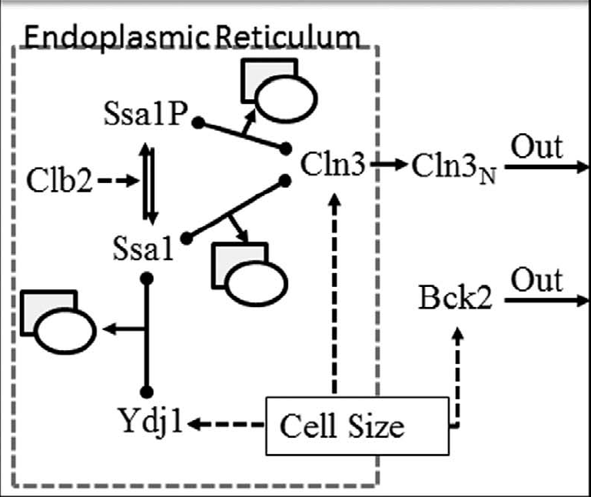
Integrating Network Algorithms and ODE Modeling in Systems Biology
TM Murali, John J. Tyson, Jean Peccoud
Identify key Interactions
Reconcile the model
Build the ODE-model
Validate Predictions
Identify Model Parameters
Simulate the model & prioritize predictions
$\frac{d\left[Ydj1\right]}{dt}=[Ydj1_{T}]\left(1−e^{−V/v_{Ydj1}}\right)$...

