Slide 1
Reconstruction and
Characterization of Novel Network Components Associated with Wnt Signaling Pathways
Shiv D. Kale, PhD

Slide 2
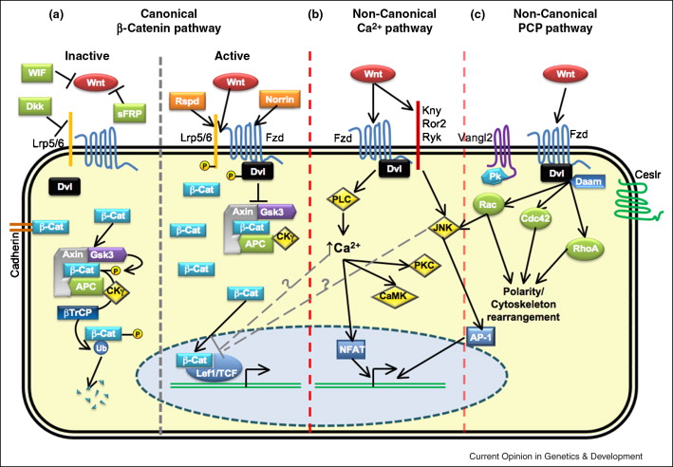
Research Background
Wnt proteins:
Highly conserved secreted glycolipid protein family (~19 such in humans)
Conserved amongst most of multicellular eukaryotic life, from primates to fish to to insects
Known to play specific roles in embroygenesis, homeostasis, cancer, and wound response.
Functions through canonical and noncanonical molecular pathways
Can we detect novel protein-protein interactions associated with Wnt Signaling Through Computational Analysis. Can we correlate these findings/ provide insight into the physiology of Cancer and Wound Response.

Slide 3
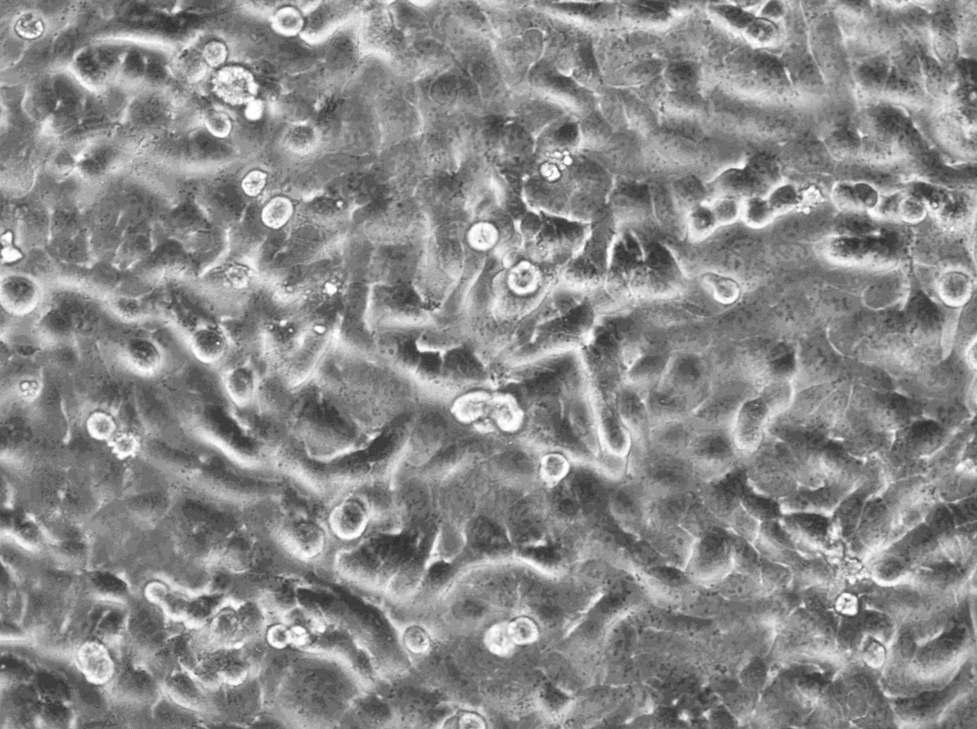
Research Highlights
Technical
Designed and Implemented a Rapid High-throughout 96-well assay to determine role of proteins in Wnt Signal Transduction to TCF/LEF promoter binding site via luciferase readout. Easily amenable to other promoter binding sites, chemicals, and proteins.
Day
0
Day
1
Day
3
Plate Cells and
siRNA Silence
Gene of interest
Transfect Luciferase Reporter And Wnt Stimulus
Measure
Luminescence
Signaling
No Signaling
Notes:
<number>

Slide 4
Research Highlights
Biological
Validated a top novel prediction, CFTR, to be important in Wnt3a Signaling to TCF/LEF promoter binding site.
Validated the physical interaction in vivo between Dab2, CFTR, and Ryk as well as gained mechanistic insights into binding.

Slide 5
Research Highlights

Slide 6
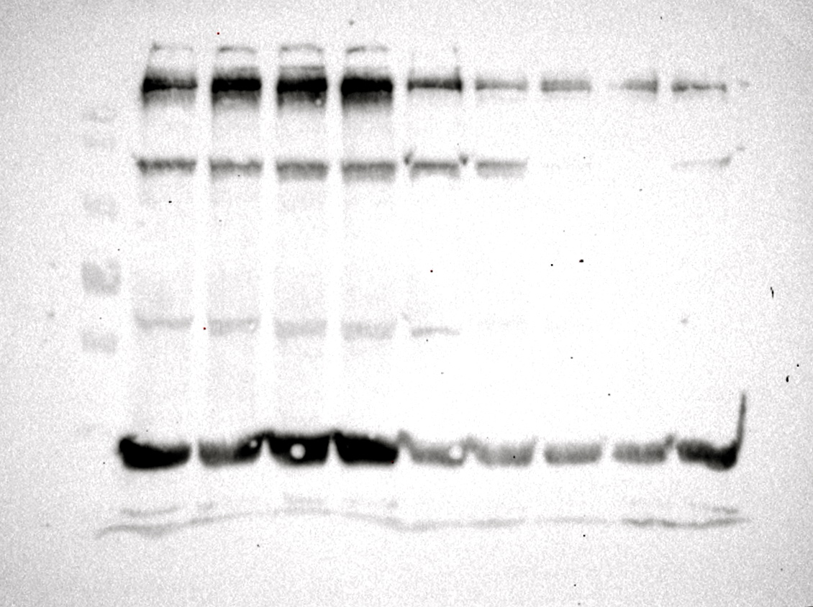
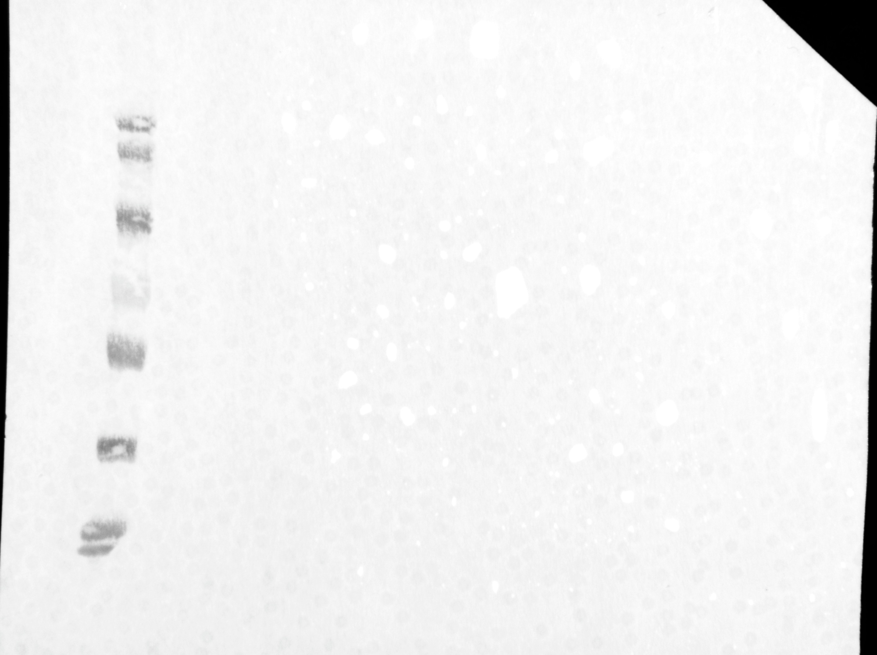
Research Highlights
BEAS-2B Cells 24hrs post Treatment
MW
Markers
Wnt5a
TGF-β
Wnt3a
EMT Mix
Control
Fibronectin
170
E-cadherin
130
Vegetative Growth
Low Fibronectin
E-cadherin present
Low Vimentin
70
55
Vimentin
43
34
EMT induction
Increase Fibronectin
Loss E-cadherin
Increase in Vimentin
GAPDH
26
17,10

Slide 7
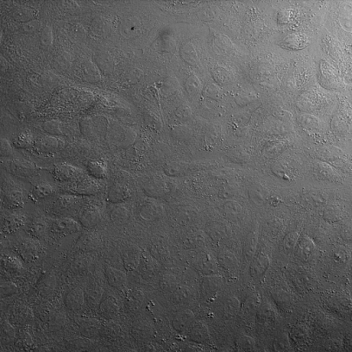
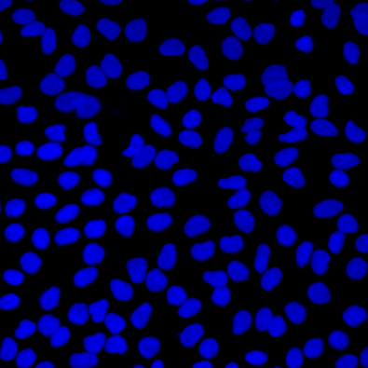
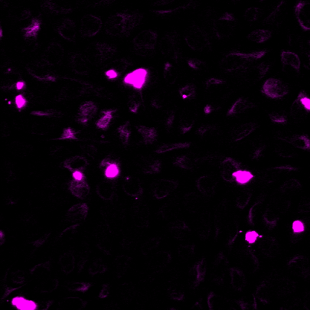
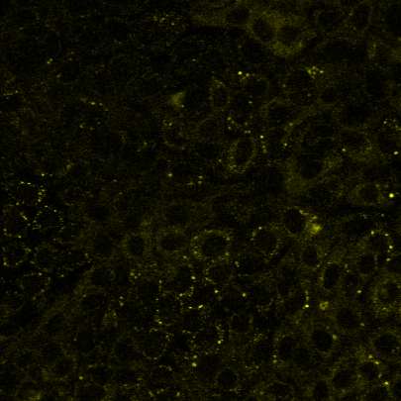
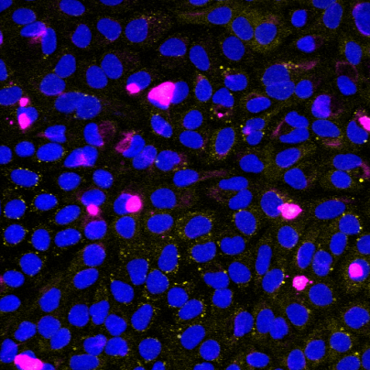
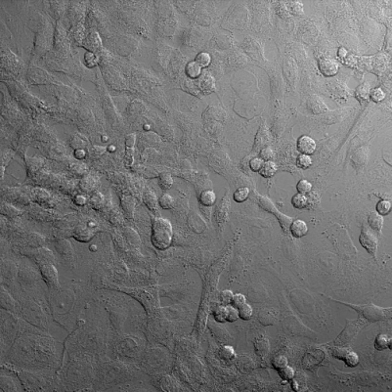
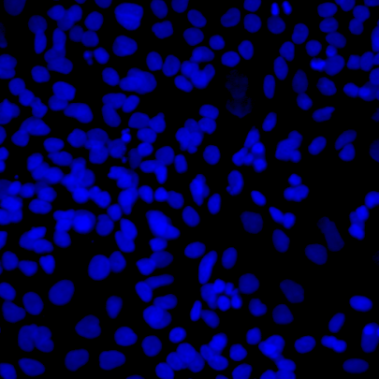
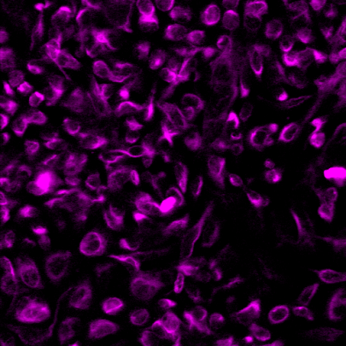
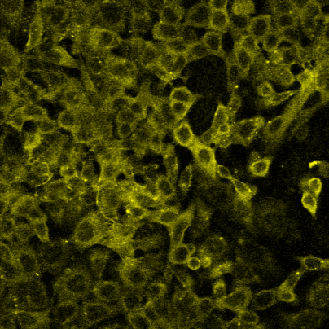
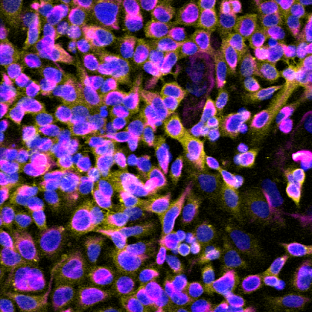
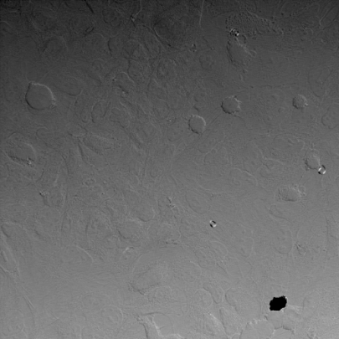
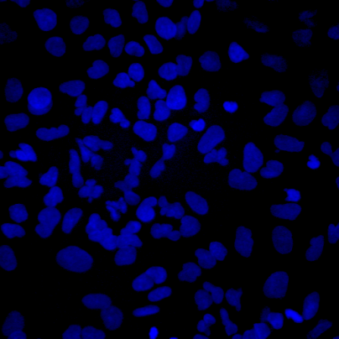
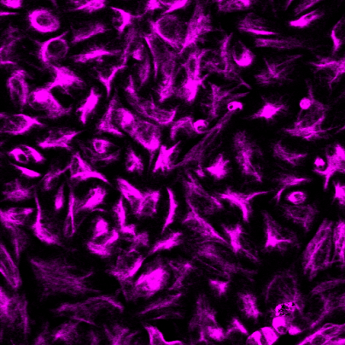
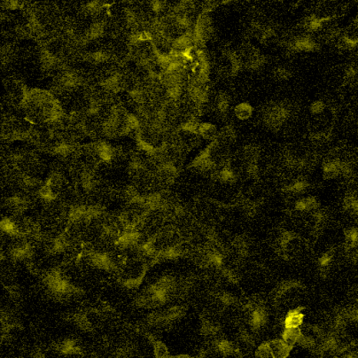
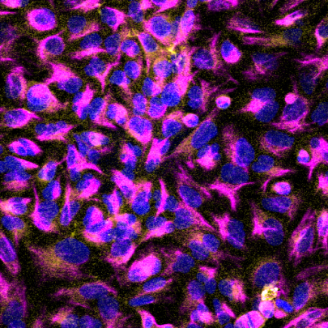
Light Image
DAPI
Vimentin
Fibronectin
Fluor. Overlay
Control
+EMT
+TGF-β

Slide 8
Future Research Plans
Linking Molecular Mechanism to Biology
  Wnt3a results in the expression of fibronectin in human airway epithelial cells.
  Fibronectin plays key roles in cellular adhesion, growth, migration, and differentiation
  These factors greatly impact homeostasis, wound healing, and cancer metastasis
Understanding Wnt Specificity and Cooperativity
  Mechanism behind how Wnt proteins signal specifically and broadly post β-catenin?
  How do Wnts cross talk with other cancer pathways and contribute to wound healing?
Animal Models to Understand Physiology of Wnt Signaling and Yield Translational Approaches
  Mouse Models of Respiratory biotic ad abiotic disease
  Can pre-/post-treatment with Wnt cocktails result in decreased tissue scaring, expedited recovery, and mitigated inflammation.

Slide 9

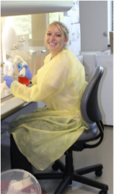
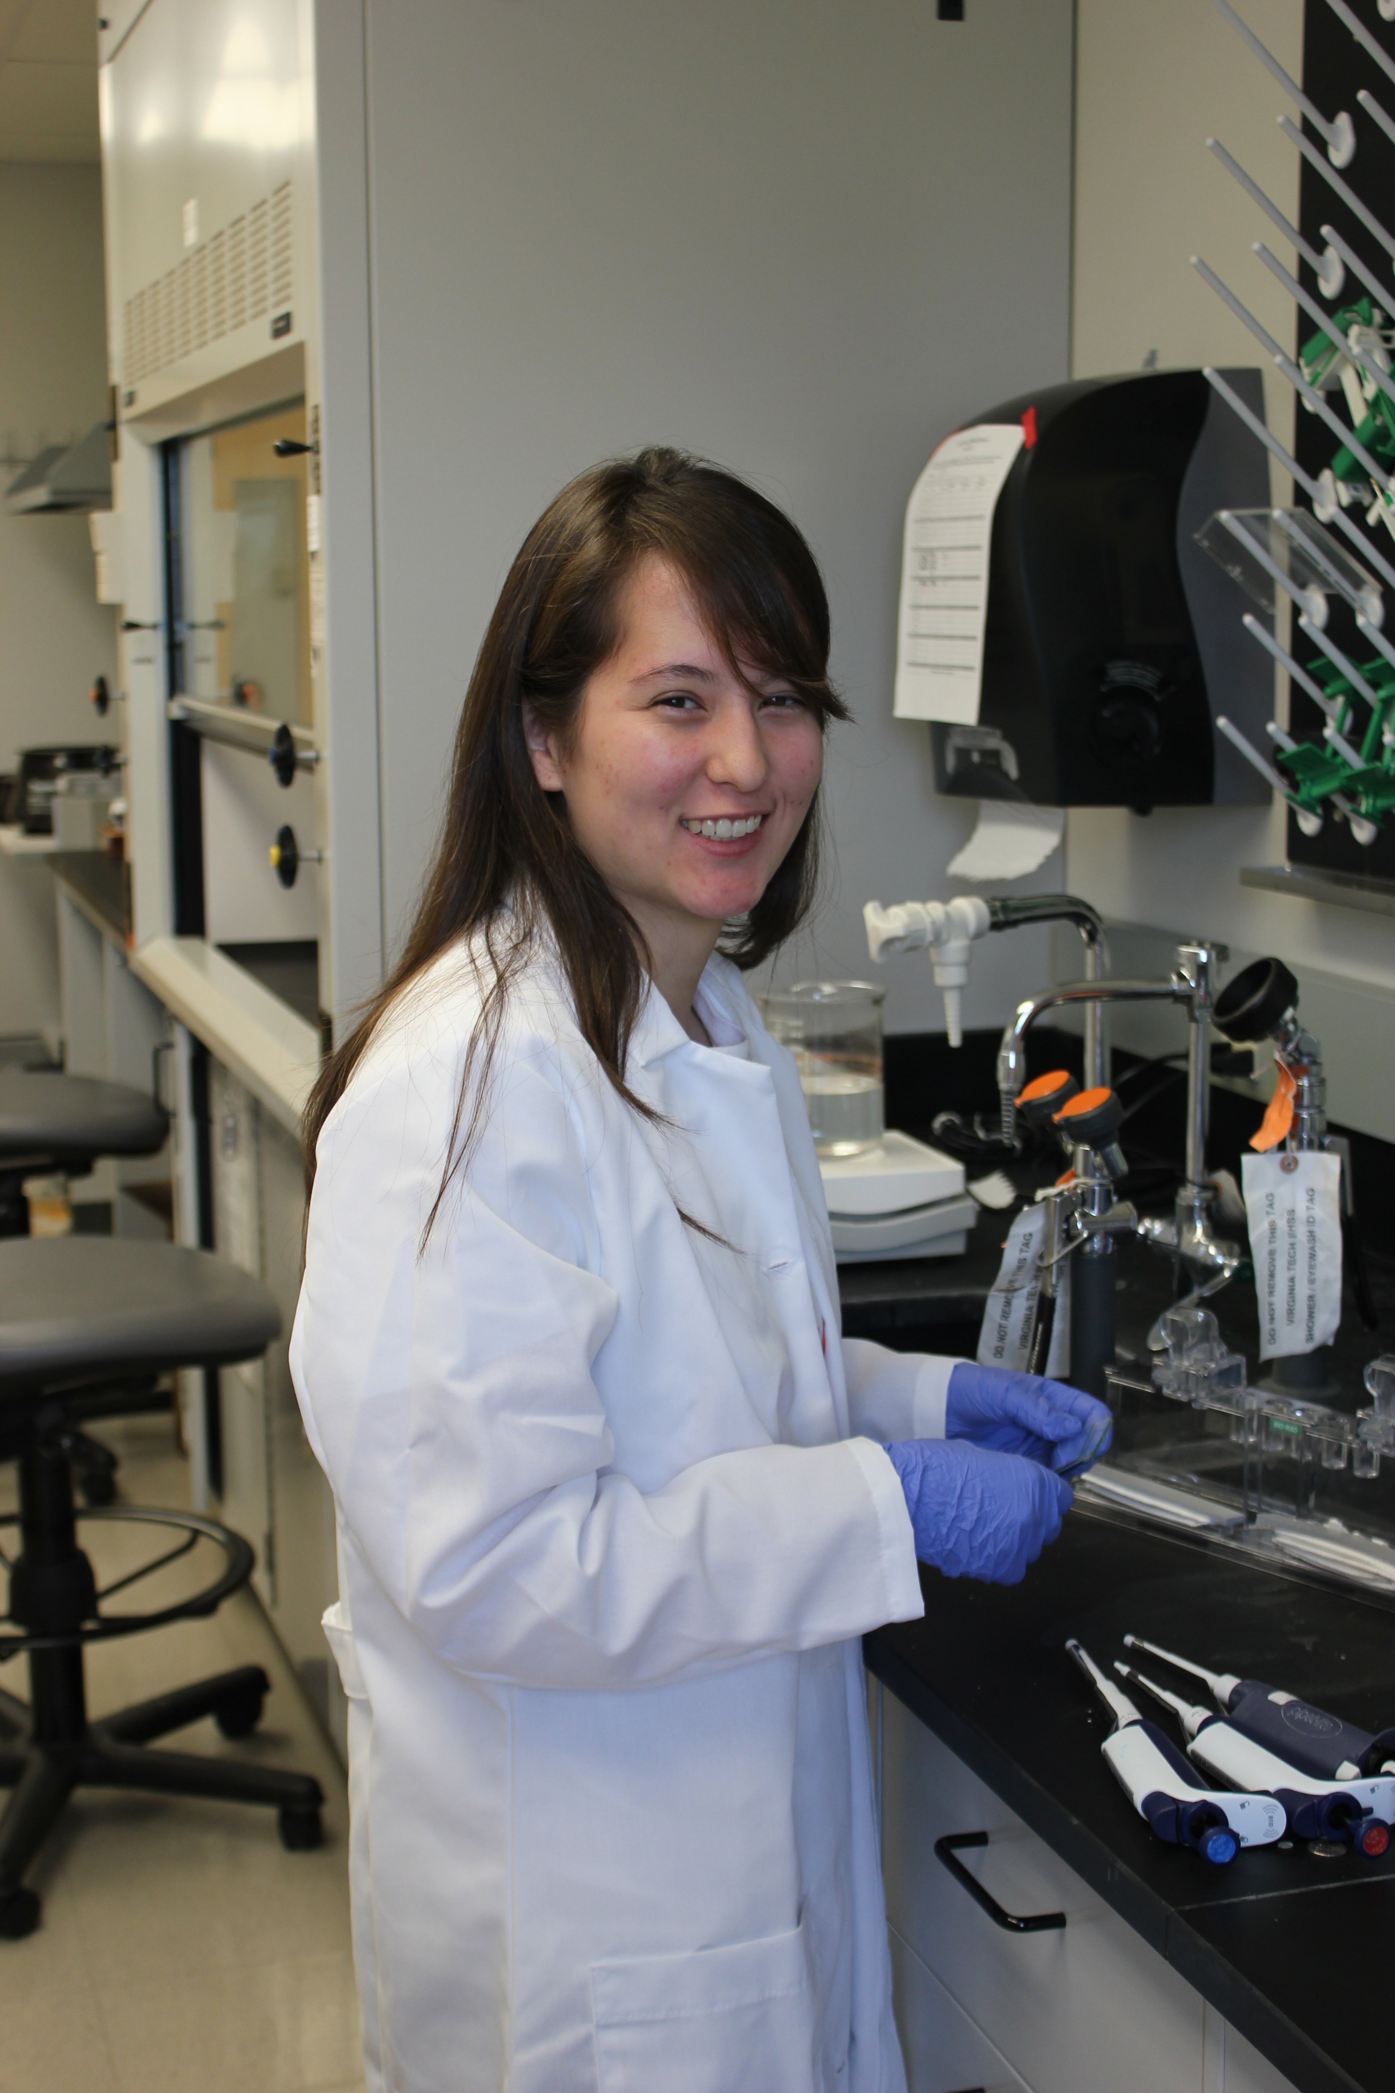
Research Team
Kale Laboratory- Wnt Signaling Project
Shiv D. Kale, PhD, Principle Investigator
Allison Powell –Undergraduate Research Assistant, Senior.
Kelsey Simmons - Undergraduate Research Assistant, Junior.
Heather Martinez - Undergraduate Research Assistant, Junior.
Prior Members:
Gloria Trivitt - Undergraduate Research Assistant.
Helen Clark - Undergraduate Research Assistant.

Slide 10
Day
0
Day
1
Day
3
Plate Cells and
siRNA Silence
Gene of interest
Transfect Luciferase Reporter and secreted Wnt3a (sWnt3a) stimulus
Measure
Luminescence
HEK293 Cells
Signaling
No Signaling
Notes:
<number>

