Slide 1
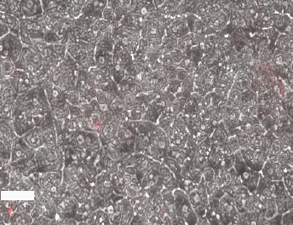
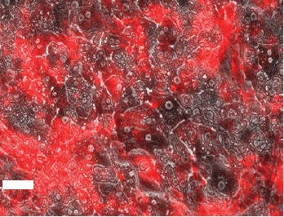
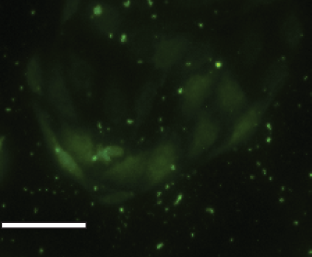
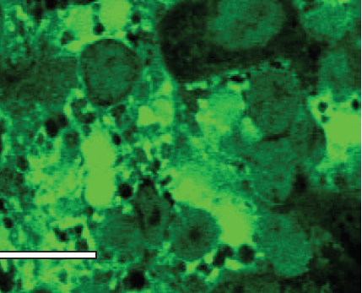
(a)
(b)
(c)
(d)
Caption: Merged phase contrast (hepatocytes) and red-fluorescent (LSECS) images taken
12 days post-isolation of heps and LSECs. A. 50K rLSECs-Hepatocytes and
B. 50K rlSECs-15 PE layers- Hepatocytes
Scale bar = 50 microns

Slide 2
A B
SE-1 immunostaining to monitor rLSEC phenotype, images obtained on
day 12 in culture. A. rLSEC monolayer, B. 50K rLSEC-15L- Hepatocyte. Scale bar = 50 microns.

