Slide 1
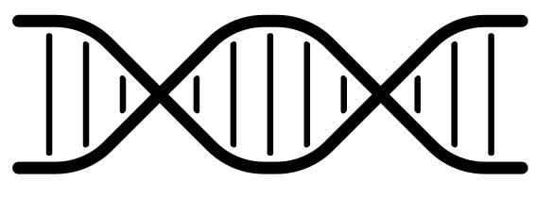
A
Reporter: 100% signal
Reporter: 50% signal
Female
Male
B
C
plasmid
plasmid
siRNA
Reporter: 75% signal
Reporter: 75% signal
Female
Male

Slide 2
Kupffer Cells
Hepatocytes
Kupffer Cells
Hepatocytes

Slide 3
A
Increased
Cell
Death
Decreased
Cell
Death
Female
Male
B
C
Decreased
Cell
Death
Increased
Cell
Death
Reporter: 100% signal
Plasmid
siRNA
Reporter: 50% signal
Plasmid
Female
Male
Male

Slide 4
TF
Reporter
Reporter
Male
Female
(Endogenous + TF Binding Sites )
(Endogenous binding sites)

Slide 5
A
TF
(Endogenous + TF Binding Sites )
(Endogenous binding sites)

